Slide 1


Slide 2
Building real world song Recommendation using Python
Submitted By : Project Guide :
Dr. Susheela Dahiya
Syed Saif Rizvi (Enroll No. R164217057) Dept. of Computer Applications
Tejas Bhatia (Enroll No. R164217058)
Vidhi Mittal (Enroll No. R164217059)
Yash Sharma (Enroll No. R164217062)

Slide 3
Abstract
A recommendation engine application that provides a person recommended songs on the basis of their listening history. On the faculty end, it gives the ability of continuous evaluation and provide the feedback to the project.
This app will contain a short description explaining the functionality of that particular project in their respective language.
Our project aims to ease the recommendation system and selection process and automate the whole process through an App. This will result in a user getting better experience and wider array of songs which he/she may like to choose from.

Slide 4
Introduction
Rapid development of mobile devices and internet has made possible for us to access different music resources freely. The number of songs available exceeds the listening capacity of single individual. People sometimes feel difficult to choose from millions of songs. Moreover, music service providers need an efficient way to manage songs and help their costumers to discover music by giving quality recommendation. Thus, there is a strong need of a good recommendation system.
In this project, we have designed, implemented and analyzed a song recommendation system.Rapid development of mobile devices and internet has made possible for us to access different music resources freely. The number of songs available exceeds the listening capacity of single individual. People sometimes feel difficult to choose from millions of songs. Moreover, music service providers need an efficient way to manage songs and help their costumers to discover music by giving quality recommendation. Thus, there is a strong need of a good recommendation system.

Slide 5
In this project, we have designed, implemented and analyzed a song recommendation system.The project is aimed to keep track and analyze the songs listened by a person in order to provide him/her a managed and classified recommendation of his/her taste. We will be developing a web-application solution to our problem. Web App would provide a Graphical User Interface(GUI) to the user to interact with the application deployed on Local Host. Jupyter Framework is a tool designed to make it easier to create, deploy, and run applications by using Python
Our project aims to ease the recommendation system and selection process and automate the whole process through an Web App. This will result in a user getting better experience and wider array of songs which he/she may like to choose from.

Slide 6
Problem Statement
There was a need for a management system Song recommendation on the basis of listener requirements. It is very time consuming for listener to search for his or her favourite songs.

Slide 7
Objective
This project aim in developing a song recommendation system for users in any application. We can analyze the preferences of a user, and on that basis, offer suitable recommendations for various subjects-books, songs, or various online shopping products
In this project we create an analytical recommendation system which interacts with user and they will be able to get excellent suggestions.
We create this project by using Python and Anaconda, and a data set of songs, available online.

Slide 8
Methodology
Functional Requirement:
The functional requirement specification of the project are mainly categorized as user requirements, security requirements, and device requirement each of which are explained in detail below:
User Requirement: User ought to have account on framework and client must have somewhere around one song listened to investigate the identity for the music suggestion.
2. Non-functional Requirement :
I. Performance: The framework will have a speedy, exact and dependable outcomes.
II. Capacity and Scalability: The framework will have the capacity to store identity registered by the framework into the database.
III. Availability: The framework will be accessible to client whenever at whatever point there is an Internet association.
IV. Flexibility and Portability: System will be available whenever from any areas

Slide 9
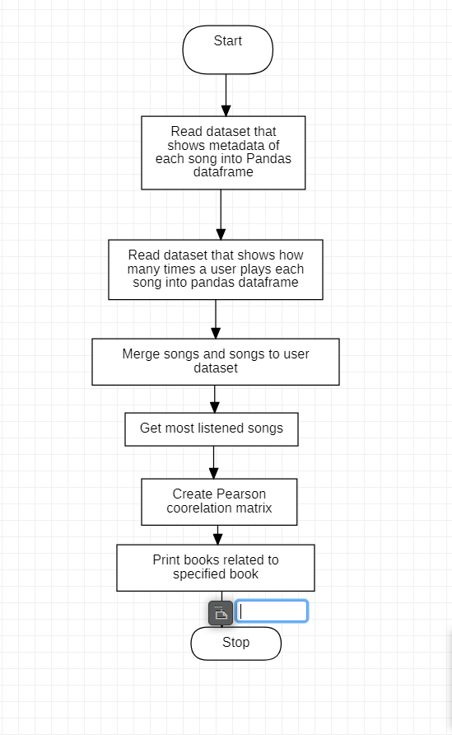
Data Flow Diagram

Slide 10
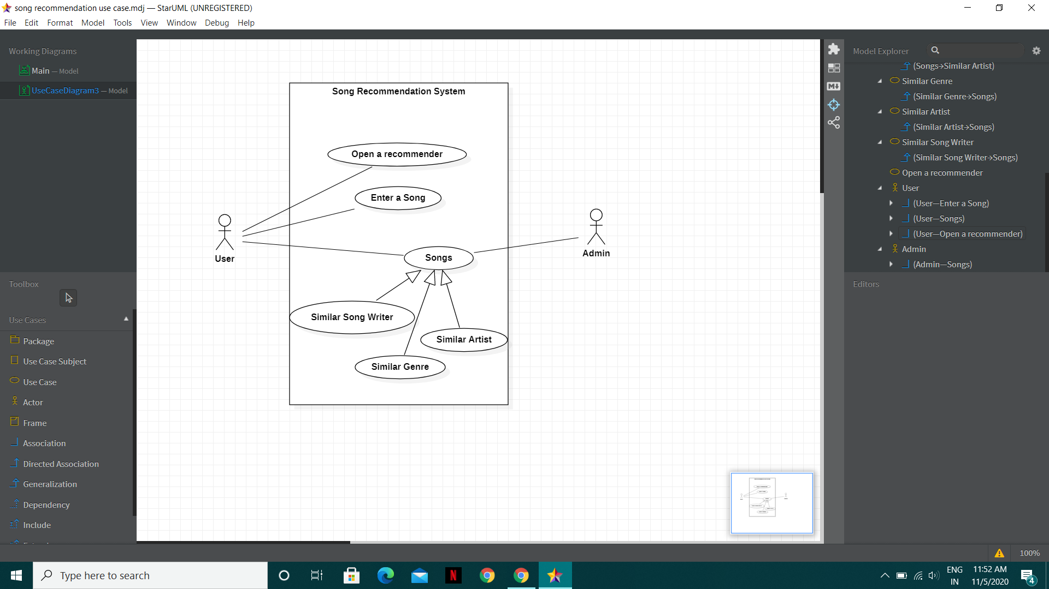
Use Case Diagram

Slide 11
Conclusion
Music recommender system is a system which learns from the user’s past listening history and recommends them songs which they would probably like to hear in future. This notebook recommends a set of music's similar to other music based on crowd sourced music played count by users. Its uses item based collaborative filtering to achieve this. Our work has given us a keen insight into recommendation systems for music. Our results have shown how we can use song metadata as well as data from users’ histories to provide the best set of songs to recommend. Furthermore, we observed the low precision results from both our own work and those from related work, which forced us to think about ways to improve overall precision. Ultimately, we devised a novel method to provide a recommendation system aimed to maximize precision of our song recommendations.

